Slide 1

Reversing the Slowdown: Executive Sales & Customer Insights
Data-Driven Diagnosis, Power BI Dashboard Demo, and Change Management Plan
Prepared by: Stanislau Yakubouski • Date: August 18, 2026 • Project Scope: 24-month transactional analysis (Dynamics 365 CRM, ERP, Customer Service Logs, NPS)

Slide 2
Problem Statement & Project Objectives
The Problem
Project Objectives
Sales growth has decelerated to 2.00% YoY, eroding revenue resilience. Repeat purchase rates in CA and TX fell from ~35% to ~25% over the last 12 months. Lack of visibility into whether root causes are product, service, or market execution.
1) Improve Visibility: Deliver a dynamic Power BI diagnostic dashboard by region, channel, and segment. 2) Identify Drivers: Differentiate market shifts from internal process/service gaps. 3) Actionable Recommendations: Provide three prioritized, resource-aligned interventions.

Slide 3




Structured Approach & Technical Stack
Phase 1 — Discovery (Weeks 1-2)
Phase 2 — Data Engineering (Weeks 3-4)
Gathered FR-01 to FR-09 and NFR-01 to NFR-02; defined user stories for Regional Managers, Sales Director, and Customer Service.
Consolidated Dynamics 365 CRM, ERP sales orders, and ticketing data; remediated incomplete profiles and inconsistent complaint coding.
Phase 3 — Analysis (Week 5)
Phase 4 — Dashboard & Visio (Week 6)
Performed hypothesis testing in Excel to validate trends and channel performance.
Developed Power BI report and mapped As-Is vs To-Be processes in Visio.
Technology Stack: Microsoft Excel, SQL, Power BI, MS Visio.

Slide 4
Process Optimization: As-Is → To-Be
As-Is (Manual & Fragmented)
To-Be (Automated & Proactive)
Regional Managers manually extract CRM and service logs weekly.
Data merged in Excel with VLOOKUPs and pivots; reports emailed by 5th business day.
Sales Director manually consolidates regional files. No proactive data quality checks; high human-error risk and delayed decisions.
Continuous capture from CRM, ERP, and ticketing systems.
Daily incremental ETL into SQL Server data mart; automated Power BI refresh by 08:00 with RLS.
Proactive Teams alerts and monthly reviews focused on action, not data gathering.

Slide 5
Financial Performance & Decelerating Growth
Metric
Prior Year
Current Year
YoY Change / Status
Total Sales Amount
$551,535.00
$562,566.29
+2.00% — ⚠️ Decelerating
Total Cost Amount
$371,845.00
$379,930.08
+2.17% — 📈 Increasing
Gross Profit
$179,690.00
$182,636.21
+1.64% — ⚠️ Lagging
Gross Profit Margin
32.58%
32.46%
-0.12% — 📉 Eroding
Key takeaway: Sales growth flattened at exactly 2.00% while costs rose faster (+2.17%), subtly eroding gross margin by -0.12%.

Slide 6
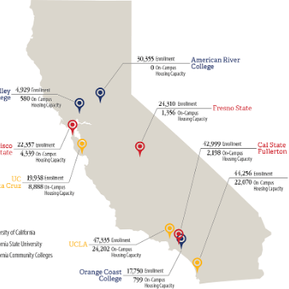
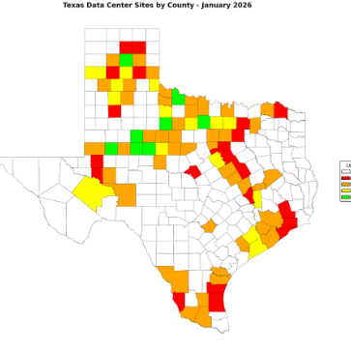
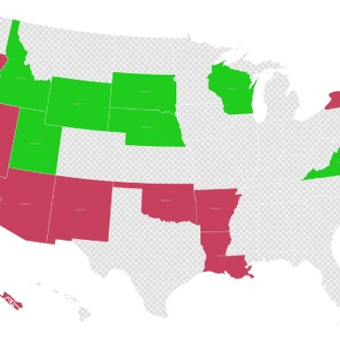
Regional Analysis: The CA & TX Retention Crisis
California (CA)
Texas (TX)
Other Regions
Repeat rate dropped from 34.90% to 24.92% — a -9.98 percentage-point decline. t-test p-value = 0.01 (t-stat = 2.7) indicating statistical significance.
Repeat rate dropped from 34.87% to 25.12% — a -9.75 percentage-point decline. Highly significant and not random fluctuation.
NY ~30% (stable), FL ~30% (slight increase), IL ~29.73% (stable), WA 30.11% (flat). The retention drop is highly localized to CA and TX.

Slide 7
Channel Analysis & Average Order Value (AOV)
Average Order Value comparison: Online AOV = $634.25 (N=960); Direct AOV = $656.61 (N=543). Hypothesis test (Online vs Direct) yields t-stat = -0.5436, p-value = 0.59 → no statistically significant difference in order sizes.
Strategic insight: Since transaction sizes are equivalent across channels, the slowdown is driven by purchase frequency (retention) rather than channel-specific pricing or cart size.

Slide 8





Power BI Dashboard: Structure & Navigation
Page 0 — Description
Page 1 — Executive Summary
Page 2 — Regional Performance
Landing page with user role guides, interactive instructions, and embedded feedback form link.
High-level KPIs (Sales, Growth, Repeat Rate, NPS) with 24-month trend line and alert thresholds.
Profitability matrix by region and channel to spot underperforming segments.
Page 3 — Customer Insights
Page 4 — Order Details
Cohort analysis of repeat purchases, sales by customer type, and repeat distribution.
Granular transactional table with one-click export to Excel for investigative work.

Slide 9
Training, Change Management & Communications
Training Rollout
1
Phase 1 (Week -2 to Launch): Leadership & Regional Managers — 1-hour interactive virtual workshops on strategy, KPIs, and drill-throughs. Phase 2 (Week -1 to Launch): Operational Teams — hands-on sessions for cohort analysis and campaign tracking. Phase 3 (Launch Week): Technical Support — documentation walkthroughs for ETL and monitoring.
2
Communication Channels & Alerts
SharePoint Portal hosts live link, short videos (<3 min), and To-Be process maps. Teams 'Sales Insights' channel for release notes and Q&A. Automated daily 09:00 AM alert to Regional Managers if 7-day rolling repeat rate <25%, linking to filtered dashboard.
Feedback & Continuous Improvement
3
Embedded Microsoft Forms on Description page; monthly 30-minute Office Hours (first Thursday) and bi-monthly dashboard releases driven by feedback.

Slide 10





Risks, Recommendations & Next Steps
Data Quality Risk
Adoption Risk
Manual Refresh Dependence
Inconsistent Regional Definitions
Risk: Duplicate/missing OrderIDs and inconsistent complaint coding. Mitigation: Implement automated constraints and validation scripts before load. Owner: Data Engineer.
Risk: Users bypass dashboard for legacy Excel. Mitigation: Hands-on training, embed feedback, deprecate old tools. Owner: Product Manager.
Risk: Delays from manual refresh. Mitigation: Automate ETL with scheduled jobs (SQL Agent / ADF). Owner: BI Developer.
Risk: Conflicting regional mappings. Mitigation: Establish single source of truth in the data warehouse. Owner: Data Governance Lead.
1
2
Immediate Recommendations
Next Steps & Milestones
1) Targeted Retention Campaigns: Launch customer success outreach in CA & TX to address the statistically significant retention drop. 2) Standardize Complaint Taxonomy: Implement unified taxonomy across centers to improve data quality. 3) Automate ETL: Move daily refresh to fully scheduled jobs.
Aug 24, 2026: Complete Phase 1 Training (Leadership & Regional Managers).
Aug 31, 2026: Complete Phase 2 Training (Marketing & CS) and launch SharePoint portal.
Sep 1, 2026: Go-Live Power BI Dashboard & Automated Teams Alerts.
Oct 1, 2026: First Monthly Review and Feedback Assessment.

